Slide 1

SMART INDIA HACKATHON 2024
Problem Statement ID: SIH1629
Problem Statement
Title:
Freelancing Platform
Basic Details of the Team and Problem Statement
Theme:
Smart Education
PS Category:
Software
Institute Name:
Chandigarh College
of Engineering
Team Name:
Tech Titans

Slide 2

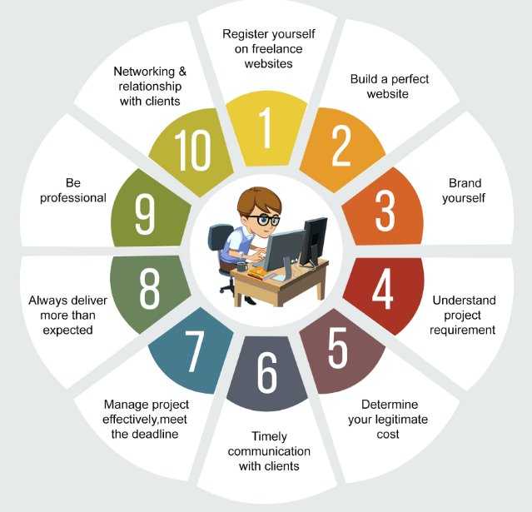
IdeaTitle:
"Freelan: AI-Powered Personalized Learning and Freelance Platform for Enhanced Skill Development"
This title highlights the core aspects of our project, such as the AI-driven personalized learning paths, the integration of freelance opportunities, and the focus on skill development. It also captures the innovative approach of combining education with real-world applications, making it stand out in the competition.
Unique features with Proposed Solutions:
AI-Powered Personalized Learning Paths:
Solution: Freelan leverages advanced AI algorithms to create individualized learning paths for each user. By analyzing a user's current skills, goals, and progress, the AI recommends tailored courses, exercises, and resources that best suit their needs.
This personalized approach ensures that users focus on the skills most relevant to their career aspirations, making their learning journey more efficient and effective.

Slide 3
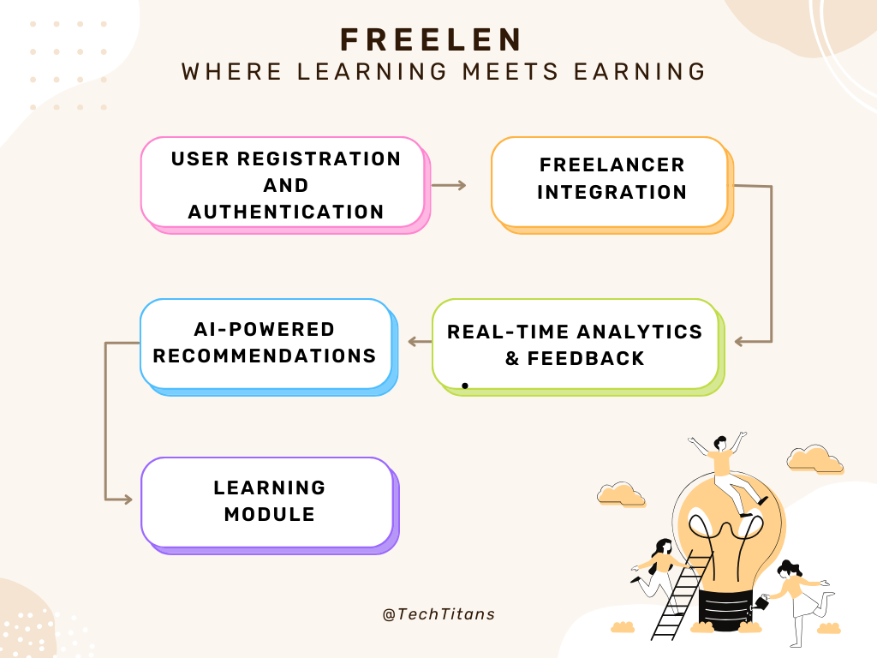
Community-Driven Collaboration:
Solution: To foster a sense of community and collaboration, Freelan integrates tools such as discussion forums, group projects, and peer reviews. These features encourage learners to interact, share knowledge, and work together on projects, mimicking real-world team dynamics. This collaborative environment not only enhances learning but also builds a strong network of peers and mentors.
Freelance Integration for Real-World Application:
Freelan bridges the gap between learning and practical experience by offering users the opportunity to apply their skills on freelance projects. The platform connects learners with real-world projects that match their skills, allowing them to gain hands-on experience while earning income.
Portfolio Featue
Real-Time Analytics and Feedback
Up-to-Date and Relevant Content

Slide 4










TECHNICAL APPROACH
FRONT END:
HTML CSS JAVASCRIT Bootstrap
BACK END:
Nodejs Expressjs Passportjs sockit.io
Bodyparser Axios API
DATABASE:
PostgreSQL

Slide 5
FEASIBILITY
TECHNICAL: Leveraging existing AI, machine learning, and cloud technologies makes Freelan technically viable. Open-source tools and APIs can streamline development, while cloud services ensure scalability.
FINANCIAL: Initial funding can be sourced through grants, investors, and partnerships. Revenue streams include subscriptions, commissions, and corporate collaborations, supporting long-term sustainability.
OPERATIONAL: High-quality content creation and maintaining user engagement are critical. AI-driven content updates and community-building features will enhance user retention.
VISIBILITY
MARKET POSITIONING: Freelan’s unique integration of AI-driven personalized learning with real-world freelancing sets it apart in the EdTech and gig economy markets.
TARGET AUDIENCE: Aimed at students, professionals, and freelancers, Freelan addresses the growing demand for continuous learning and practical skill application.
MARKETING STRATEGY: Launch visibility through the Smart India Hackathon, combined with strategic partnerships, content marketing, and social media outreach, will drive brand awareness and user acquisition.

Slide 6
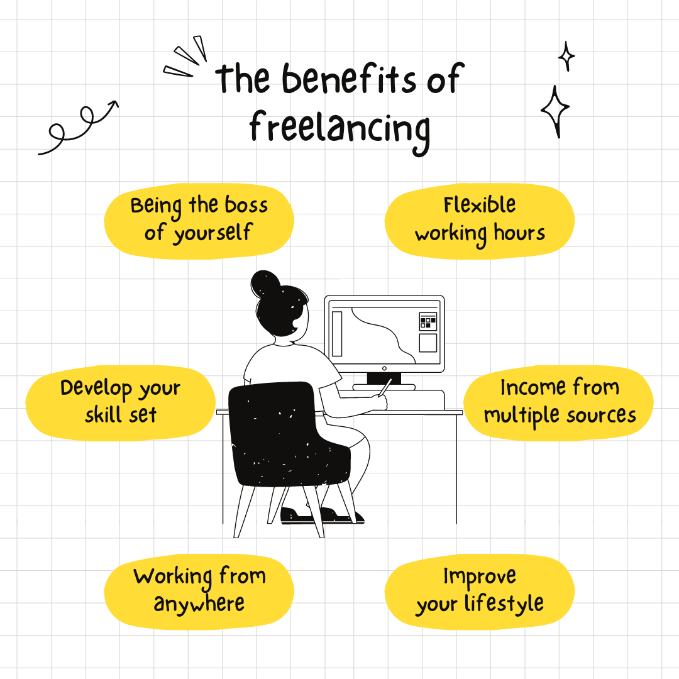
Impacts & Benefits
Empowering Personalized Learning:
Impact: Tailored learning paths for more effective education.
Benefit: Users achieve career goals faster with relevant skills
Bridging the Gap Between Learning and Employment:
Impact: Integrates freelance projects with learning.
Benefit: Users gain practical experience and income while learning.
Increased Engagement:
Impact: Gamification boosts motivation and course completion.
Benefit: Users stay engaged and reach their goals.
Collaborative Community:
Impact: Encourages peer interaction and teamwork.
Benefit: Users build valuable connections and support networks.
5. Up-to-Date Skills:
Impact: AI-curated content keeps learning current.
Benefit: Users stay competitive with the latest industry skills.
6. Lifelong Learning:
Impact: Continuous skill development opportunities.
Benefit: Users adapt and grow in a changing job market.

Slide 7
TEAM MEMBER DETAILS
Team leader
Name: Mr. Raju kumar Roll no:2338514 Stream: CSE Year:2nd
2. Team member 1:
Name: Mr.Raj Sharma Roll no:2338511 Stream: CSE Year:2nd
3. Team member 2:
Name : Mr. Rishav Kumar singh Roll no:2338519 Stream: CSE Year:2nd
4. Team member 3:
Name: Mr. Shivam Mishra Roll no:2338539 Stream: CSE Year:2nd
5. Team member 4:
Name: Mr. Sayan Dev Roll no:2338536 Stream: CSE Year:2nd
6. Team member 4:
Name: Miss. Swarn Jyoti Roll no:2338547 Stream: CSE Year:2nd

Slide 8

Thank You

